Slide 1
Veridian IT Agent
Policy-Aware Internal IT Support Agent
Assignment 2: Internal Service Agent (IT Support)
Presented by: Anurag Pandey
AI Agent • RAG • Policy Reasoning • Controlled Tools • Audit Trail

Slide 2
Business Problem
The Problem
Employees submit IT requests in natural language.
Different requests require different company policies and approval processes.
Some requests can be resolved automatically.
Some requests require additional information before a decision can be made.
Sensitive requests, such as phishing incidents, must be escalated safely.
Traditional support workflows can create unnecessary back-and-forth.
Goal
Build an AI agent that can:
Understand → Retrieve Policy → Reason → Decide → Act/Escalate → Audit

Slide 3
Our Solution
Veridian IT Agent
A policy-aware AI agent that handles internal IT support requests using the supplied company knowledge base.
Key Capabilities
Understand employee requests
Retrieve relevant IT policies
Reason over request + policy
Ask follow-up questions
Resolve supported requests
Create structured tickets
Escalate risky or restricted requests
Display policy/source evidence
Maintain an audit trail
Four possible outcomes
RESOLVE | ASK FOLLOW-UP | CREATE TICKET | ESCALATE

Slide 4
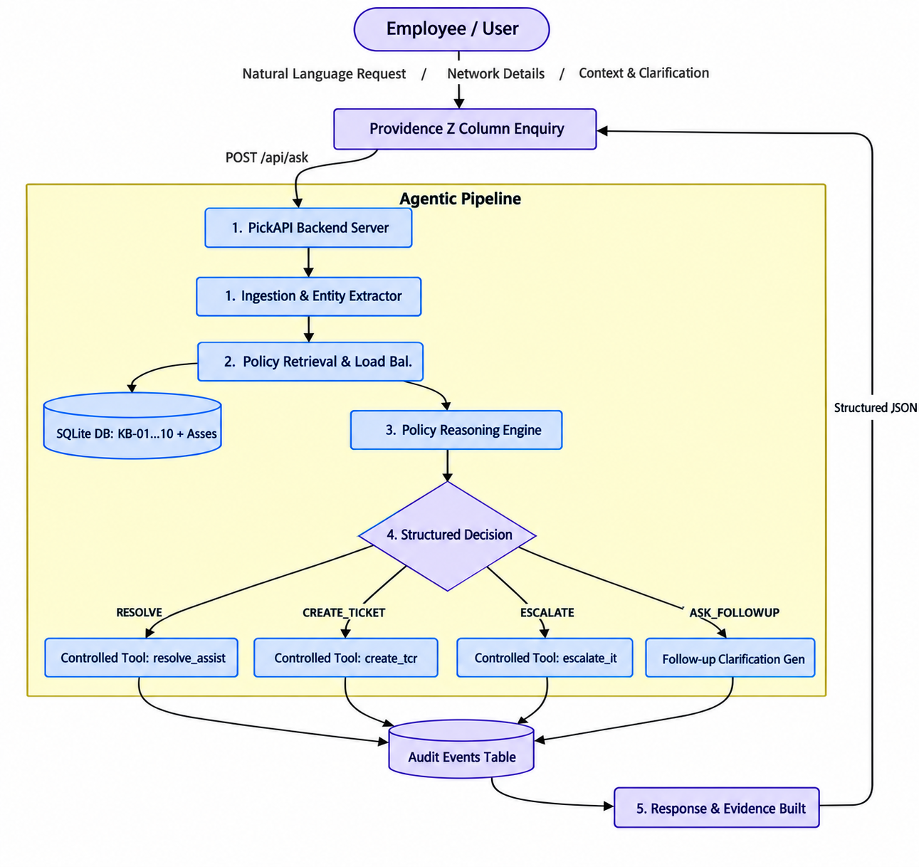
System Architecture
Technology Stack
Frontend: React + Vite
Backend: FastAPI
AI: LLM
Knowledge: IT Policy KB / RAG
Database: SQLite
Deployment: Vercel + backend deployment

Slide 5
Agentic Workflow
1. Employee Request
↓
2. Understand Intent
↓
3. Retrieve Relevant Policy
↓
4. Evaluate Request Against Policy
↓
5. Make Decision
↓
6. Validate Action
↓
7. Execute Controlled Tool
↓
8. Generate Response
↓
9. Record Audit Event
Every employee interaction follows 5 strictly audited stages:
INGESTION / REQUEST_RECEIVED: Ingests the query, extracts entities (failed attempts, device age, remote work days).
RETRIEVAL / POLICY_RETRIEVED: Performs multi-signal retrieval over local SQLite policy records.
REASONING / DECISION_MADE: Evaluates request against retrieved policy constraints and historical ticket precedents (TK-1042..TK-1051). Categorizes into RESOLVE, ASK_FOLLOWUP, CREATE_TICKET, or ESCALATE.
EXECUTION / ACTION_EXECUTED: Invokes the whitelisted controlled tool if preconditions are met.
COMPLETION / RESPONSE_GENERATED: Assembles the policy-grounded employee response with source citation and timestamped audit record.

Slide 6
RAG & Policy Grounding
Employee Request
↓
Relevant Policy Retrieval
↓
Policy + Request
↓
Agent Decision
↓
Source Evidence
Key Principle
The agent should not invent policies or information that are not present in the supplied knowledge base.

Slide 7
Guardrails & Controlled Tools
get_request_context()
retrieve_policy()
reset_password()
create_ticket()
escalate_ticket()
Safety Controls
Backend validates tool actions.
No arbitrary SQL execution.
No arbitrary shell commands.
No arbitrary network requests.
No fabricated policies.
Unsupported requests trigger clarification or escalation.
Security incidents follow the dedicated security policy.
Failed actions are not reported as successful.
Request Received
↓
Policy Retrieved
↓
Decision Made
↓
Action / Escalation
↓
Response Generated

Slide 8
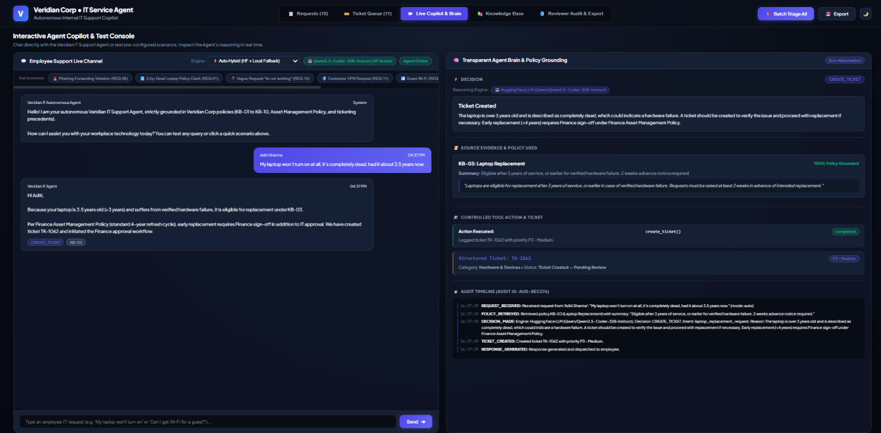
Live Demo Scenarios

Slide 9
Reliability, Testing & Limitations
Testing
The application tests important agent behaviors including:
Password lockout
Contractor VPN
Non-catalog software
Phishing escalation
Ambiguous requests
Policy grounding
Tool validation
Ticket creation
Audit logging
Reliability
Policy-grounded responses
Structured agent decisions
Controlled tool execution
Source evidence
Audit events
Error handling
Current Prototype Limitations
Demo environment rather than a production ITSM system
Simulated enterprise integrations
Limited employee identity/authentication
SQLite-based persistence

Slide 10
Conclusion & Future Scope
A policy-aware agent that can understand, retrieve, reason, act, escalate and audit internal IT requests.
Future Scope
ServiceNow/Jira integration
Enterprise SSO
Role-based access control
Production vector database
Agent evaluation and monitoring
Human approval workflows
More enterprise IT automation
Links
Live Demo: https://veridian-it-agent-pi.vercel.app/
GitHub: https://github.com/Anurag637/Veridian-IT-Agent
Video Link: Drive Video Link
“From IT request to policy-grounded resolution — with controlled AI actions and complete traceability.”

